Slide 1


Fraud Detection
Dani Rahardjo
03 March 2025

Slide 2

List of Contents
Background & Problem Statement
Objectives & Scope
Data Collection
Data Preprocessing
EDA & Feature Engineering
Feature Selection
Correlation Matrix
Modelling

Slide 3

Background & Problem Statement
Background
With the increase in digital transactions in recent years, such as e-commerce, online banking, digital payments and fintech, this has opened up new opportunities for fraud, one of which is illegal credit card transaction activity. According to a report by the Association of Certified Fraud Examiners (ACFE), it is known that losses reach trillions of dollars per year, with methods that are increasingly sophisticated and difficult to detect.
Problem Statement:
The increase in fraudulent credit card transactions in the digital era requires the development of a strong and efficient fraud detection system. This project aims to develop a machine learning model to detect credit card fraud. The model will be trained on a historical credit card transaction dataset and evaluated on an unseen transaction dataset.

Slide 4
Objectives & Scope
Objective:
Create and compare machine learning models that predict whether customers will commit fraud. The goal is to identify fraudulent customers and suggest retention strategies.
Scope:
The project uses a dataset with customer information, and the analysis is focused on applying classification techniques like Logistic Regression, Random Forest and XGBoost.
The dataset can download here.

Slide 5
Data Collection
Data Source:
The dataset used, fraudTrain.csv, contains customer details :
trans_date_trans_time: Waktu transaksi. Dapat digunakan untuk mendeteksi pola waktu (misal transaksi yang sering terjadi pada waktu yang tidak wajar bisa dicurigai sebagai fraud).
cc_num: Nomor kartu kredit. Informasi penting terkait pengguna kartu, tetapi tidak langsung membantu mendeteksi fraud kecuali ada pola dari penggunaan kartu yang tidak biasa.
merchant: Nama merchant (penjual). Merchant tertentu mungkin lebih sering terlibat dalam transaksi fraud, sehingga bisa membantu mendeteksi risiko terkait merchant.
category: Kategori transaksi. Fraud mungkin lebih sering terjadi dalam kategori tertentu seperti barang mewah atau hiburan, yang memiliki nilai transaksi lebih tinggi.
amt: Jumlah uang dalam transaksi. Nilai transaksi yang sangat besar atau tidak sesuai dengan pola belanja biasanya bisa menjadi tanda fraud.
first: Nama depan pemegang kartu. Tidak terlalu relevan dalam mendeteksi fraud secara langsung.
last: Nama belakang pemegang kartu. Sama seperti first, tidak relevan secara langsung.
gender: Jenis kelamin pemegang kartu. Bisa digunakan untuk melihat pola demografis terkait fraud, meskipun tidak secara langsung mengindikasikan fraud.
street: Alamat jalan pemegang kartu. Dapat digunakan dalam deteksi anomali jika lokasi transaksi berbeda jauh dari alamat pemegang kartu.
city: Kota pemegang kartu. Sama seperti street, dapat digunakan untuk memeriksa ketidaksesuaian antara lokasi pemegang kartu dan transaksi.
state: Negara bagian pemegang kartu. Sama dengan city, bisa mendeteksi anomali lokasi.
zip: Kode pos pemegang kartu. Sama dengan city dan state, bisa membantu mendeteksi anomali geografis.
lat: Garis lintang lokasi pemegang kartu. Lokasi geografis dapat membantu mendeteksi ketidaksesuaian jika dibandingkan dengan lokasi transaksi.
long: Garis bujur lokasi pemegang kartu. Sama dengan lat, membantu mendeteksi lokasi.
city_pop: Populasi kota pemegang kartu. Bisa digunakan untuk memahami risiko terkait daerah, misalnya daerah padat penduduk mungkin memiliki lebih banyak transaksi dan risiko.
job: Pekerjaan pemegang kartu. Pekerjaan dengan penghasilan tinggi mungkin lebih rentan terhadap fraud karena lebih sering terlibat dalam transaksi besar.
dob: Tanggal lahir pemegang kartu. Usia pemegang kartu bisa menjadi faktor, misalnya kelompok usia tertentu mungkin lebih rentan terhadap fraud.
trans_num: ID unik untuk transaksi. Tidak relevan dalam deteksi fraud secara langsung.
unix_time: Waktu transaksi dalam format unix. Sama seperti trans_date_trans_time, membantu dalam menganalisis pola waktu.
merch_lat: Garis lintang merchant. Dapat digunakan untuk mendeteksi ketidaksesuaian antara lokasi merchant dan pemegang kartu.
merch_long: Garis bujur merchant. Sama seperti merch_lat, membantu mendeteksi anomali lokasi.
is_fraud: Label apakah transaksi adalah fraud (0 = tidak fraud, 1 = fraud). Ini adalah target yang perlu diprediksi.

Slide 6
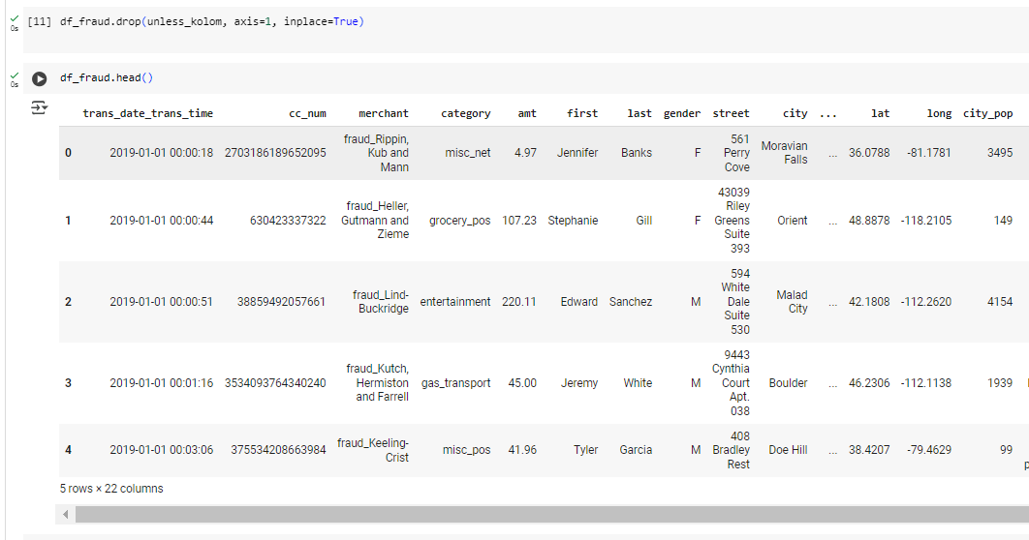
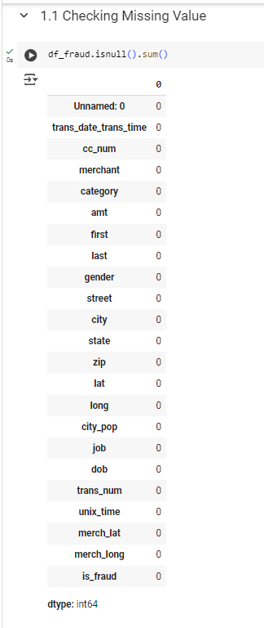
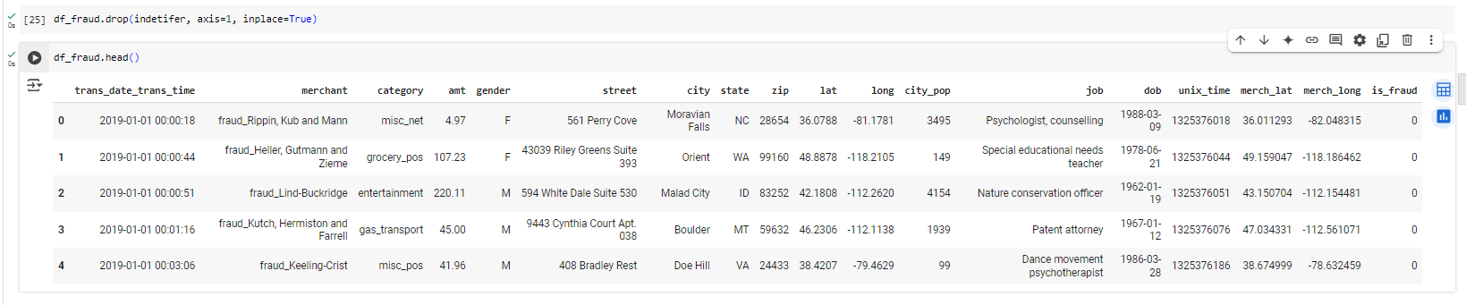
Drop Column not Needed:
unless_kolom = ['Unnamed: 0’]
indetifer = ['cc_num', 'first', 'last', 'trans_num’]
Data Preprocessing
Data Preprocessing:
No missing values were found.

Slide 7
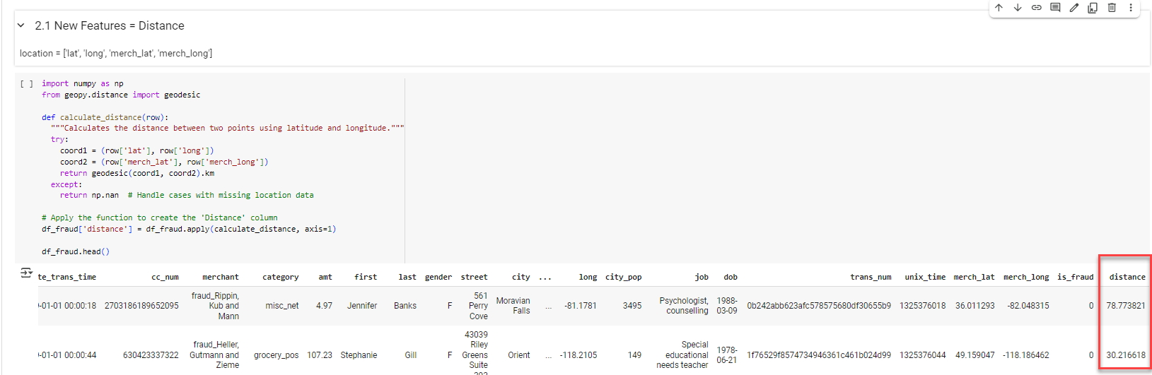
Exploratory Data Analysis (EDA) and Feature Engineering
New Features : Distance
Displays a new feature called Distance with a column in the location in kilometers

Slide 8
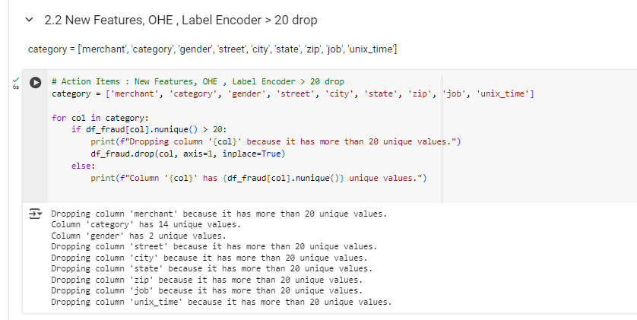
Exploratory Data Analysis (EDA) and Feature Engineering
New Features : OHE , Label Encoder > 20 drop
Display a new feature with filter column category ['merchant', 'category', 'gender', 'street', 'city', 'state', 'zip', 'job', 'unix_time’] has more than 20 unique values then will be drop.

Slide 9
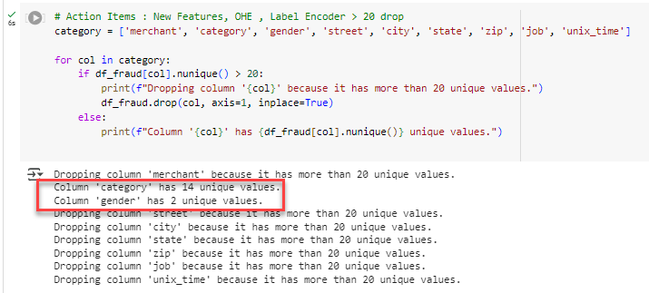
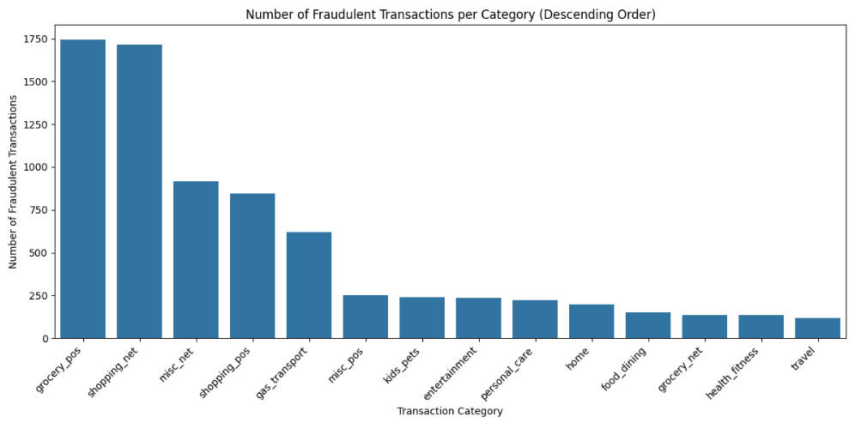
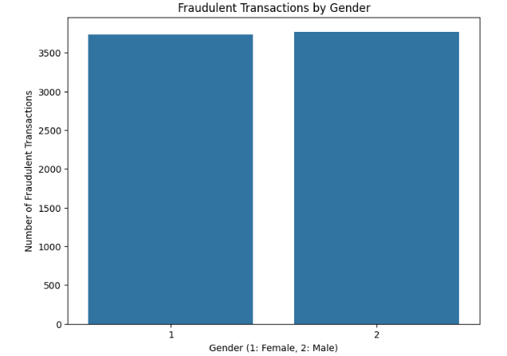
Exploratory Data Analysis (EDA) and Feature Engineering
New Features, OHE , Label Encoder > 20 drop
Display a new feature with filter column category ['merchant', 'category', 'gender', 'street', 'city', 'state', 'zip', 'job', 'unix_time’] has more than 20 unique values then will be drop.

Slide 10
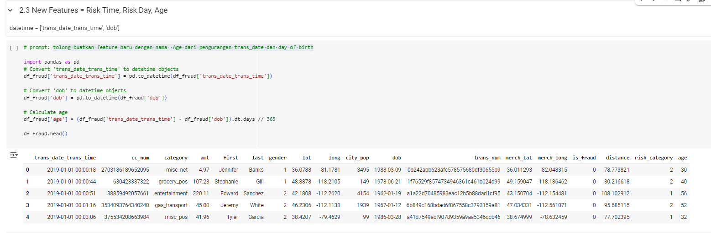
Exploratory Data Analysis (EDA) and Feature Engineering
New Features : Risk Time, Risk Day, Age
Display a new feature with the name Age from subtraction of trans_date and day of birth

Slide 11
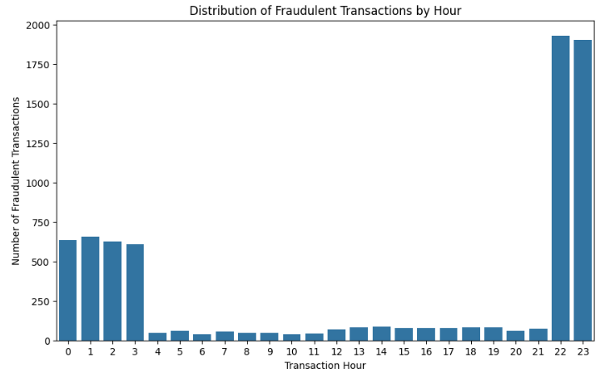
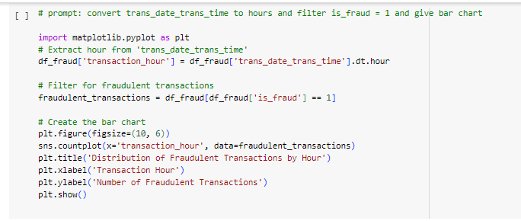
Exploratory Data Analysis (EDA) and Feature Engineering
New Features : Risk Time, Risk Day, Age
Display a new feature with the name Age from subtraction of trans_date and day of birth
Insight : Abnormal transactions were found, the possibility of fraudulent transactions occurring around 22:00 to 03:00

Slide 12
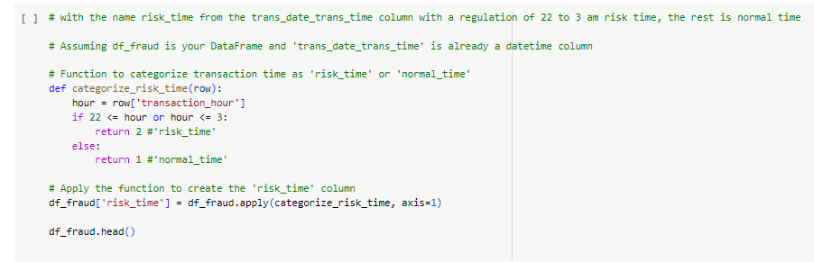
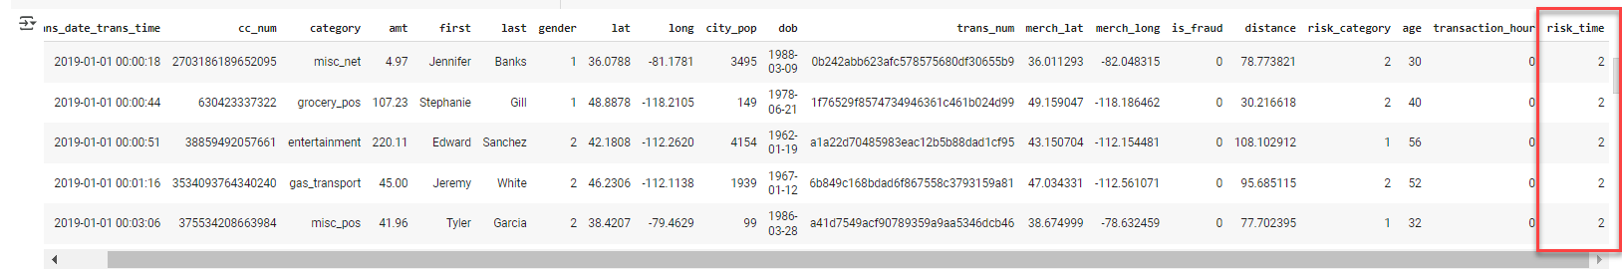
Exploratory Data Analysis (EDA) and Feature Engineering
New Features : Risk Time, Risk Day, Age
Display a new feature with the name risk_time from the trans_date_trans_time column with a regulation of 22 to 3 am risk time, the rest is normal time

Slide 13
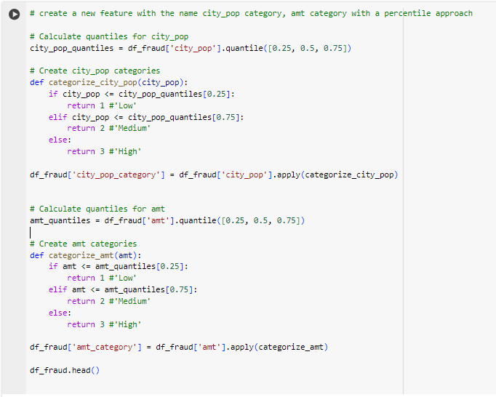
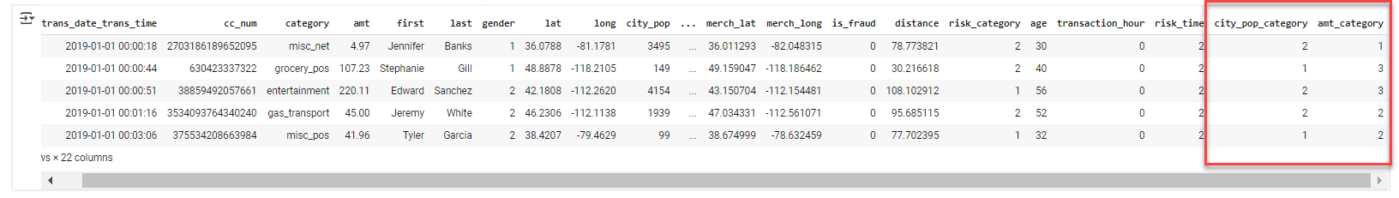
Exploratory Data Analysis (EDA) and Feature Engineering
New Features : City Pop Category, Amt Category
Display a new feature with the name city_pop category, amt category with a percentile approach

Slide 14
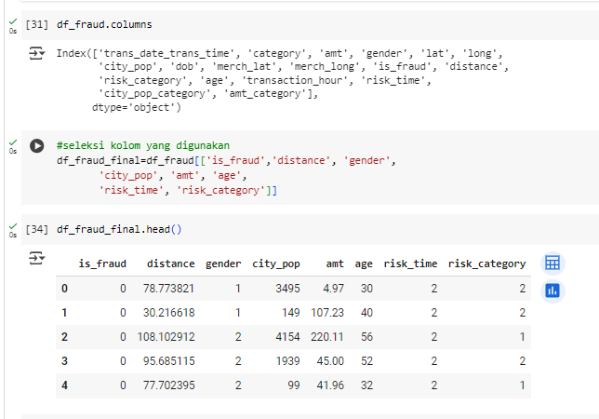
Feature Selection
New Features : City Pop Category, Amt Category

Slide 15
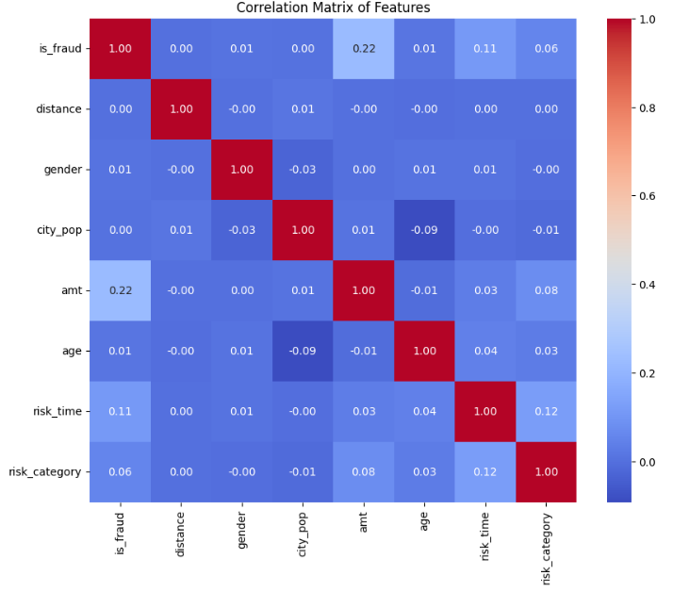
Correlation Matrix
New Features : City Pop Category, Amt Category

Slide 16
Model Development
Models Used:
Logistic Regression: A linear model for binary classification tasks.
Random Forest: An ensemble learning method based on decision trees.
XGBoost: A gradient-boosting framework known for high performance in machine learning tasks.
Model Evaluation Metrics:
Precision
Recall
F1-Score
Accuracy
SMOTE:
Used to handle class imbalance by oversampling the minority class.

Slide 17
Training & Optimization
Logistic Regression:
Logistic Regression model was trained on balanced data with SMOTE.
Random Forest:
Random Forest model was trained on balanced data with SMOTE.
AdaBoost:
AdaBoost model was trained on balanced data with SMOTE.
Feature Engineering:
New features like Distance, Risk Category, Gender, Risk Time, Age, City Pop and AMT Category were created to enhance the model’s understanding of customer behavior and increase prediction accuracy.

Slide 18
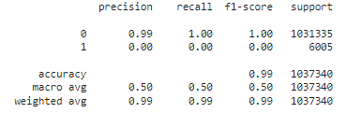
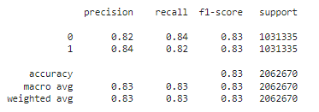
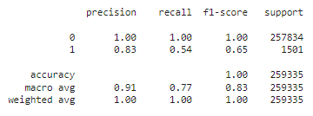
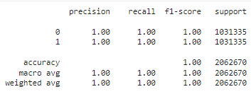
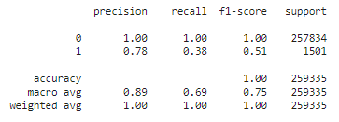
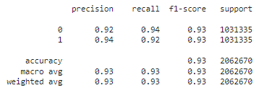
Results Modelling
Logistic Regression without SMOTE
Logistic Regression with SMOTE
Random Forest without SMOTE
Random Forest with SMOTE
AdaBoost without SMOTE
AdaBoost with SMOTE

Slide 19
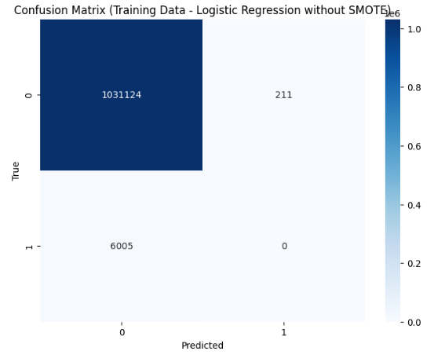
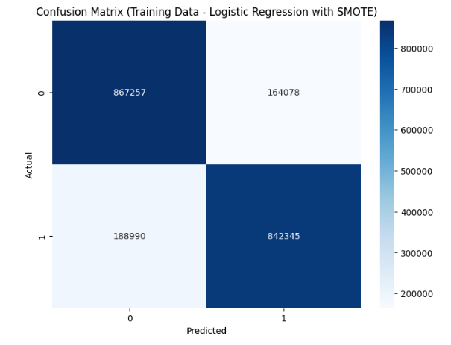
Confusion Matrix
Logistic Regression without SMOTE
Logistic Regression with SMOTE

Slide 20
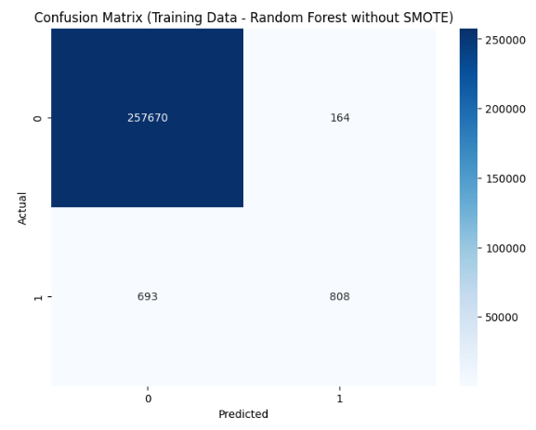
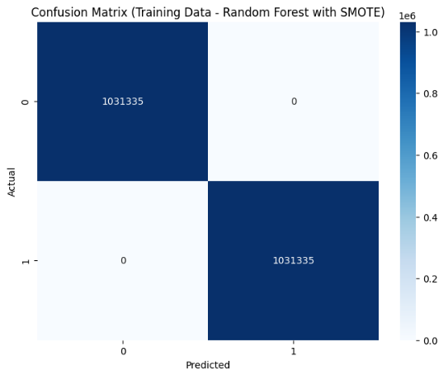
Confusion Matrix
Random Forest without SMOTE
Random Forest with SMOTE

Slide 21
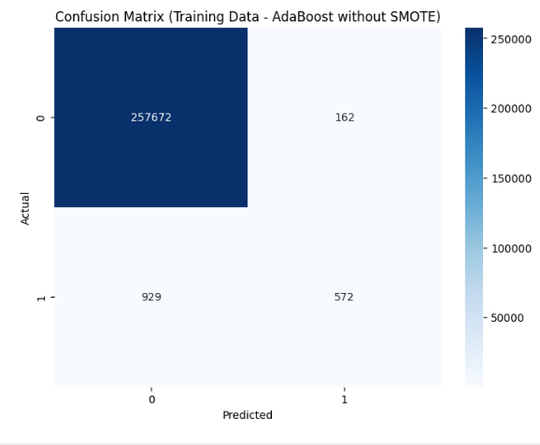
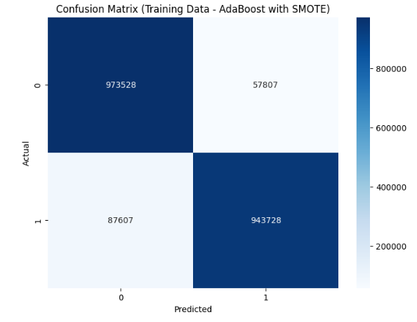
Confusion Matrix
AdaBoost without SMOTE
AdaBoost with SMOTE

Slide 22
Real-world Application
Implementation:
This fraud detection model can be implemented as a module within a CRM system to help businesses identify high-risk customers.
Usage:
The output of the model would trigger proactive customer retention strategies, such as targeted offers or improved customer service, for customers predicted to churn.

Slide 23


Contact Us
Don’t hesitate to contact us for further inquiries or any collaborations.
Your Full Name
Dani Rahardjo

